Slide 1


Uncovering the Shadows: Bright Ideas to Accelerate MS Defender for Cloud Apps (MDA)

Slide 2




About Me
Cyber Automation Architect
Jay Kerai
(Stand: C169)
1
Focused on Automated Response/ Prevention of Security Incidents in MSSP environment
2
Working in Cybersecurity almost 4 years
3
Moderator of Microsoft EMS Discord
4
Security Content Creator on LinkedIn (Content Featured in Entra News, Defender Weekly Wrap, Kusto Insights)
Jay-kerai-cyber
jkerai1

Slide 3


Cloud App Security Broker
(CASB)
1
6
Governance Risk
and Compliance (App Governance + Cloud App Catalogue)
Shadow IT
(App Discovery)
Granular Cloud Usage Control to SaaS apps (Session Policy)
2
5
Threat Prevention (Malware policy)
3
4
Data Loss Prevention (File Policy)
Visibility of activity in SaaS (Activity Policy)

Slide 4

The Defender For Cloud Apps Umbrella
Entra ID OAuth Apps (Enterprise Applications)
Detect malicious OAuth Apps (Illicit Consent Grant attack)
Hunt for Overprivileged Enterprise Apps
Hunt for Apps accessing Sensitive Content
Entra ID Conditional Access – MDA Reverse Proxy
Block Copy/Paste (depending on content)
Block Hosting IPs/Anonymous IPs
Enforce Edge For Business
App Discovery
Discover/Block SaaS applications at URL level
Assess Risk of SaaS Apps (can even Bias to meet compliance requirements)
Anomaly/Activity Policy
Mass Download of files
Suspicious Inbox Forwarding
Monitor for activities towards a dark web IP
Monitor activities from Enterprise Saas apps like Slack, Dropbox
File/Malware Policy
Detects malicious files in Box, Dropbox, Google Workspace and Onedrive/Sharepoint
Apply Purview Sensitivity Labels to files hosted in Box, Google Workspace

Slide 5
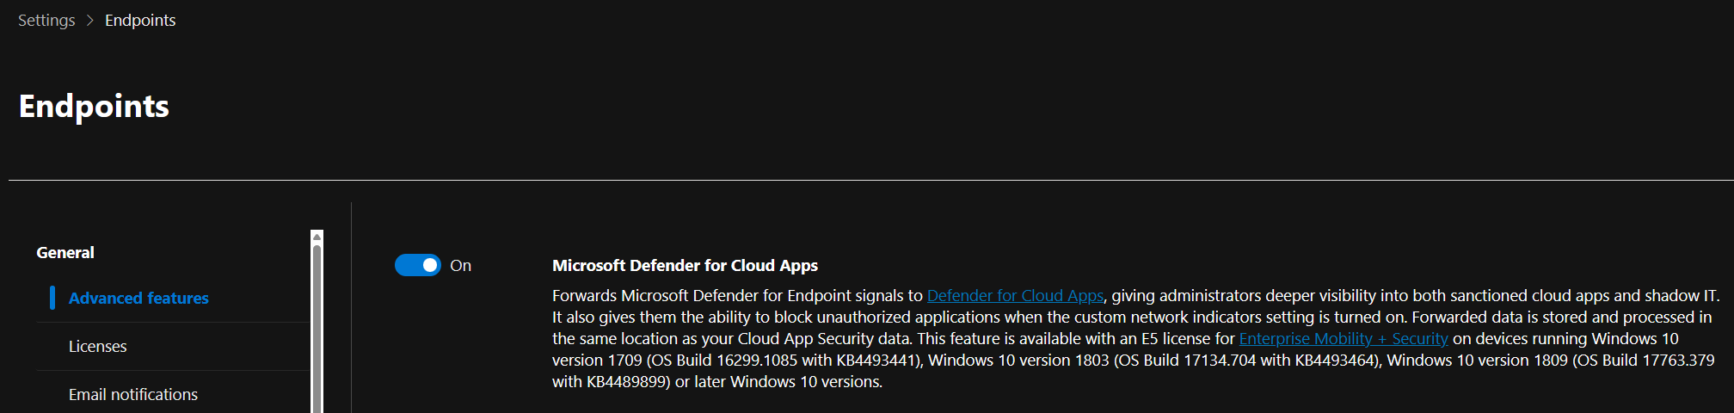
Scenario: Shadow IT SaaS Discovery
01
02
03
Easiest way to discover Apps – Use existing telemetry from MDE!
But you can use other sources such as Firewall/SWG
No VPN required!

Slide 6
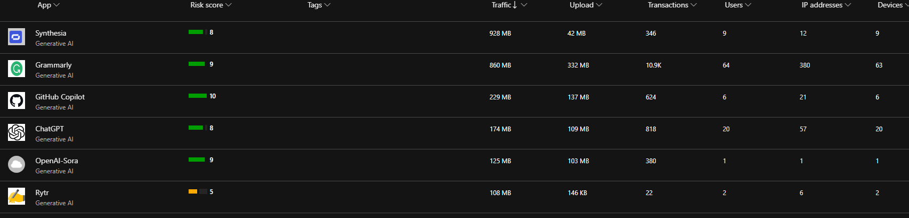
Scenario: Generative AI Shadow IT
“
“
Had to mention AI at least once.
01
02
03
Users are using Generative AI tools to perform work.
How are we ensuring we know where our data might be going?
Users may be using personal accounts to sign-in to these platforms, allows for potential exfiltration path.

Slide 7
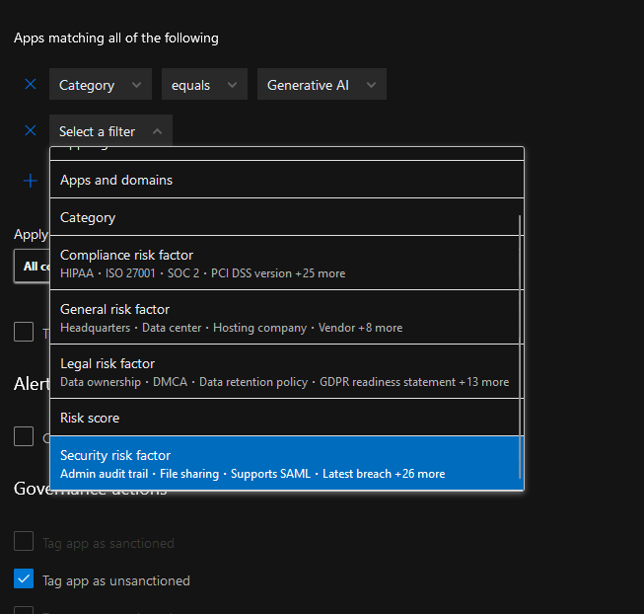
Scenario: Generative AI Shadow IT
“
Okay that’s great, Its going there but what can I do about it?
“
A.
Create an App discovery policy to start proactively blocking GenAI apps based on Risk Factors as its discovered by MDA.
Tag as Unsanctioned = Block

Slide 8
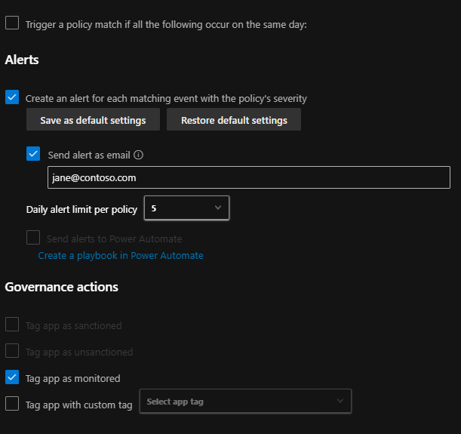
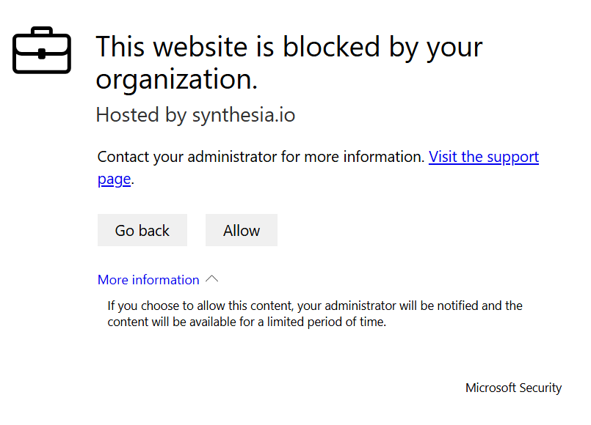
Scenario: Generative AI Shadow IT
01
Doesn’t have to be a block, can just a warn end user / alert admins.
Tag as monitored = Warn Indicator in MDE

Slide 9
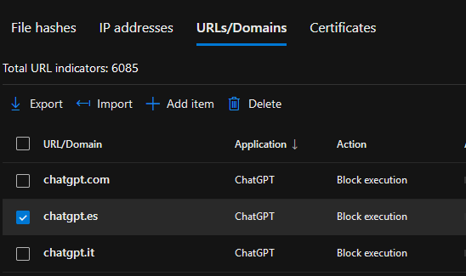
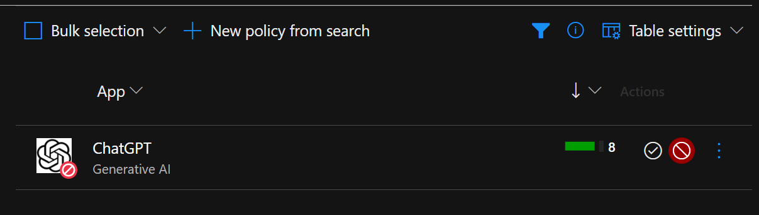
Scenario: Generative AI Shadow IT
01
02
03
What if I don't want to wait for it to be discovered/it's already been discovered?
Manually block from the app catalogue!
Ensures Domains remain automatically updated.

Slide 10
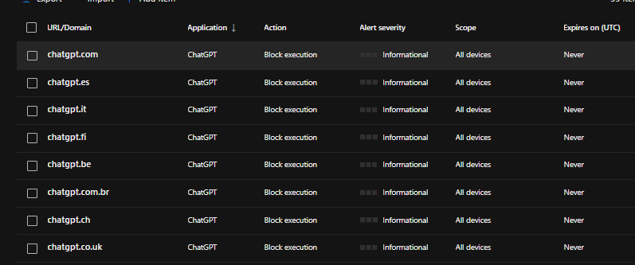
01
02
03
More Chatgpt Domains!
MDA automatically handles any new domains, taking away admin overhead.
M365 Copilot License worth it in discouraging GenAI Shadow IT

Slide 11
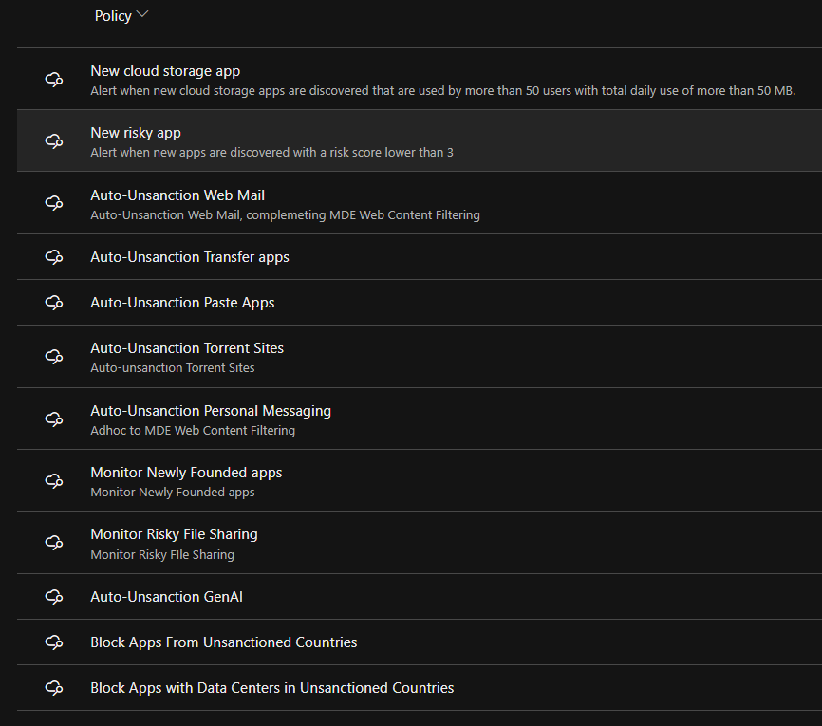
Why Stop There?
Other Ideas for discovery policy:
All Policies are on my Github.

Slide 12
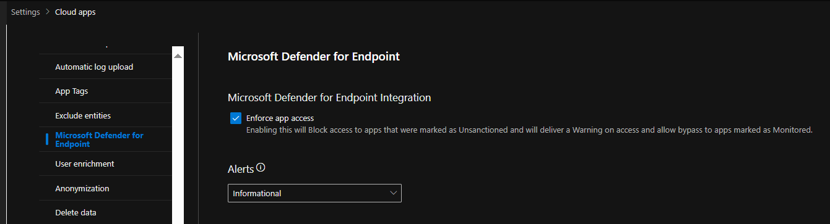
Don’t Forget to Enforce MDA Blocks Back to MDE
01
02
Super Common Mistake!
Review Discovered Unsanctioned Applications before turning on.

Slide 13




Better Together Story
Microsoft Stack
App Governance complements Entra ID Enterprise Applications
App Governance complements Automatic Attack Disruption
1
App Discovery Complements MDE Telemetry (and blocking)
Activity Policy Governance of Confirm User Compromised complements Entra ID Identity Protection
2
Activity /Anomaly Complements Office365/Azure
Activity Policy complements existing SaaS apps you may already have
3
File Policy Complements Purview Sensitivity Labels
Access/Session Policy complements Conditional Access and Edge For Business
Session Policy Complements Purview SITs
Unsanctioning Applications complements MDE Web Content Filtering
GenAI Discovery complements DPSM for AI in Purview

Slide 14

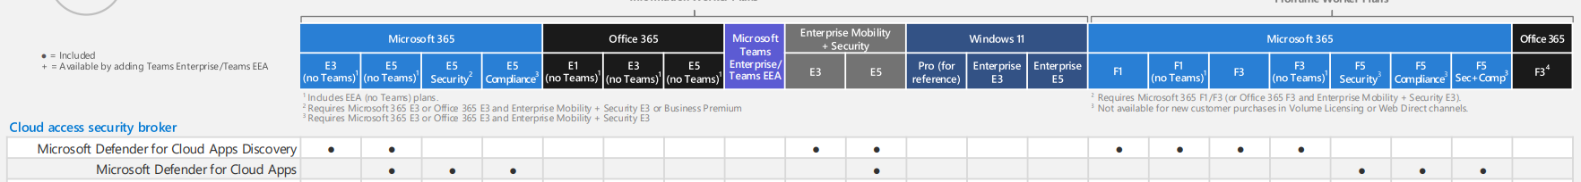
License
The Full Cloud App Security Suite is included in M365 E5/E5 EMS/F5
Cloud app Discovery is included in E3 and business premium*
*This is only the discovery. You cannot enforce the unsanctioned applications back to Defender for Endpoint without Defender for Endpoint P2.
Can upgrade to E5 for Business Premium! (300 seats, ~57% saving against purchasing products individually)

Slide 15


Thank You

